Slide 1


Antweight Battle Bot
Electrical & Computer Engineering
Team 24: Junyan Bai, Yuxuan Guo
04/30/2026

Slide 2

Introductions
Objectives/Constraints
Build a safe, controllable ≤ 2 lb antweight battlebot
Survive impacts while maintaining mobility and control
Operate reliably during a 2-minute match
Avoid brownouts during stalls and heavy motor loads
ELECTRICAL & COMPUTER ENGINEERING
GRAINGER ENGINEERING
Notes:
Just summarize all the main constraints and requirements, nothing too much

Slide 3
Introductions
High Level Requirements
Weapon: lift 0.9 kg ≥ 40 mm within 2 s; hold ≥ 5 s
Control: wireless PC control with latency ≤ 150 ms
Safety: kill switch stop ≤ 0.5 s; link-loss stop ≤ 2 s
Mobility: speed ≥ 0.4 m/s; push 1.0 kg for ≥ 2 s without brownout
ELECTRICAL & COMPUTER ENGINEERING
GRAINGER ENGINEERING
Notes:
Just summarize all the main constraints and requirements, nothing too much

Slide 4
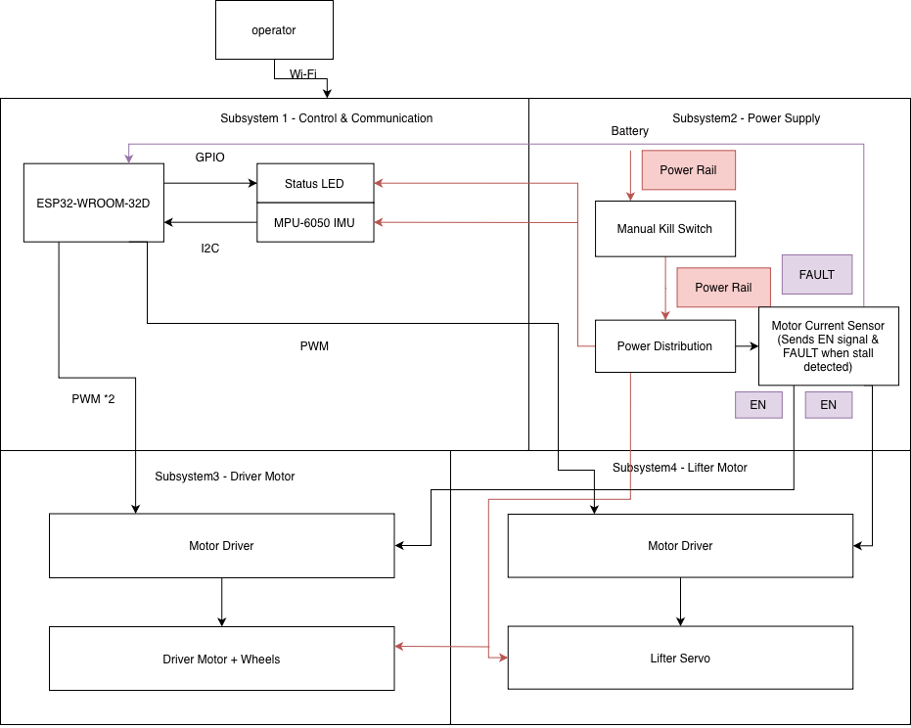
Block Diagram
Detailed visual aids on the Appendix
ELECTRICAL & COMPUTER ENGINEERING
GRAINGER ENGINEERING
Notes:
Spend 30 seconds here, mainly talking about battery, removing the 3 leg inverter for another integrated chip, and the wider wheel base and larger radius on the weapon

Slide 5


Control & Communication Subsystem
ELECTRICAL & COMPUTER ENGINEERING
GRAINGER ENGINEERING

Slide 6
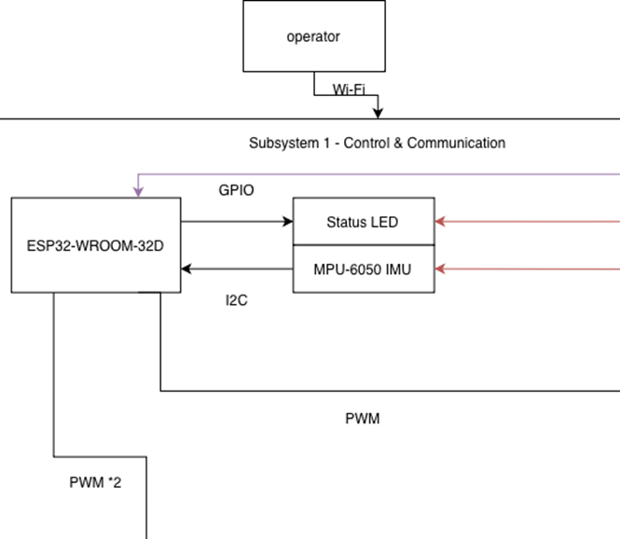
Subsystem Overview
WiFi commands
ESP32-S3 sends signals
Codes handle additional features
ELECTRICAL & COMPUTER ENGINEERING
GRAINGER ENGINEERING
Notes:
Quick here, just mention how our requirements for this subsystem are as follows and how we’re using a 300mah battery and a 3v3 buck

Slide 7
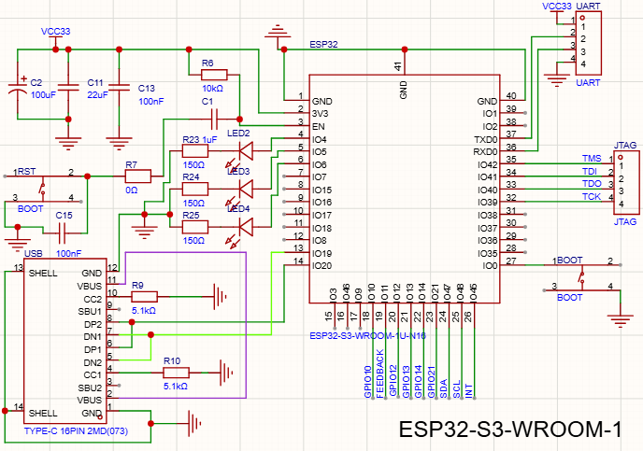
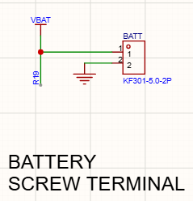
Hardware Schematic
ELECTRICAL & COMPUTER ENGINEERING
GRAINGER ENGINEERING
Notes:
Quick here, measured output from buck and found it was within spec as you can see

Slide 8
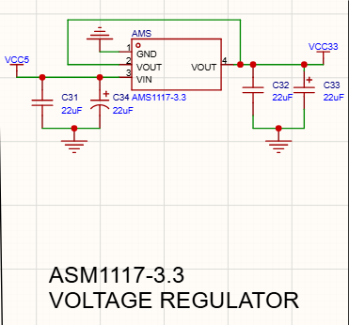
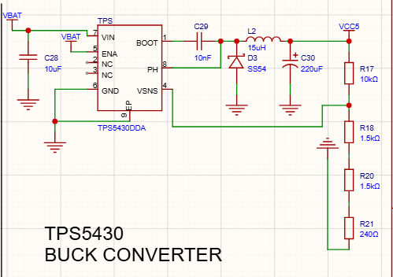
Hardware Schematic
ELECTRICAL & COMPUTER ENGINEERING
GRAINGER ENGINEERING
Notes:
Quick here, measured output from buck and found it was within spec as you can see

Slide 9
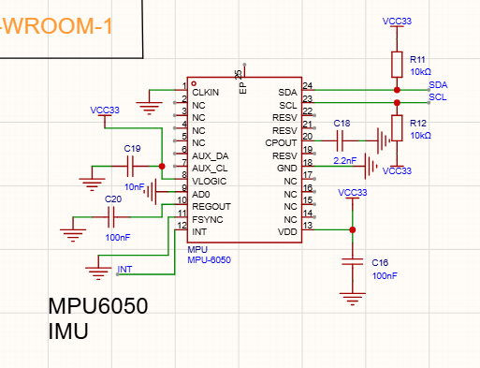
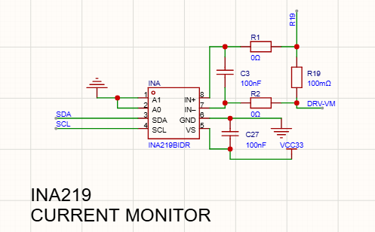
Hardware Schematic
ELECTRICAL & COMPUTER ENGINEERING
GRAINGER ENGINEERING
Notes:
Quick here, measured output from buck and found it was within spec as you can see

Slide 10
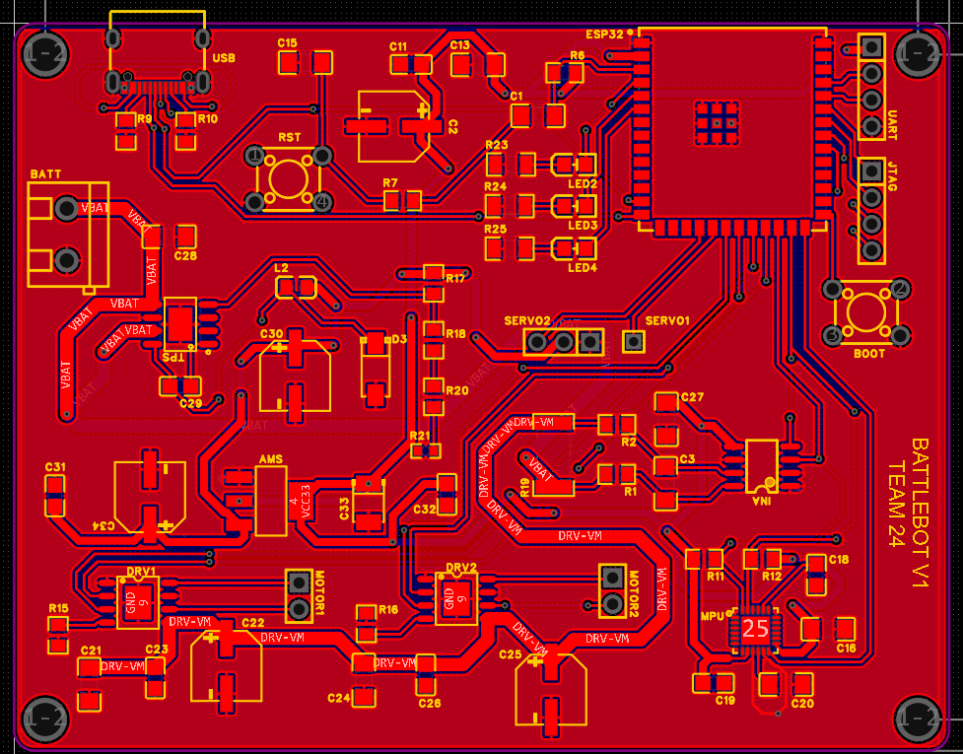
PCB Layout
ELECTRICAL & COMPUTER ENGINEERING
GRAINGER ENGINEERING

Slide 11
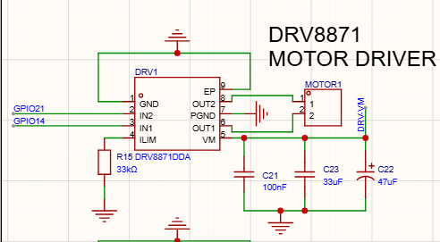
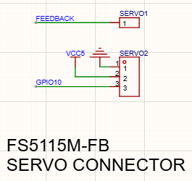
Motor Initialization and Control
Websocket → ESP32 → PWM(Pulse Width Modulation) → motor/servo signal
ELECTRICAL & COMPUTER ENGINEERING
GRAINGER ENGINEERING

Slide 12
Software / Communication Flow
ESP32 as embedded WebSocket server using softAP
Transmission through TCP
Networking through IP
Data through Wifi
ELECTRICAL & COMPUTER ENGINEERING
GRAINGER ENGINEERING
Notes:
Spend more time here, talk about how we estimated the current draw from the motors using the datasheet, when we finally ordered the motors, we were able to do current draw testing and we got the following results, which were way lower than our estimated values during our design doc, so this allowed us to size down the battery

Slide 13
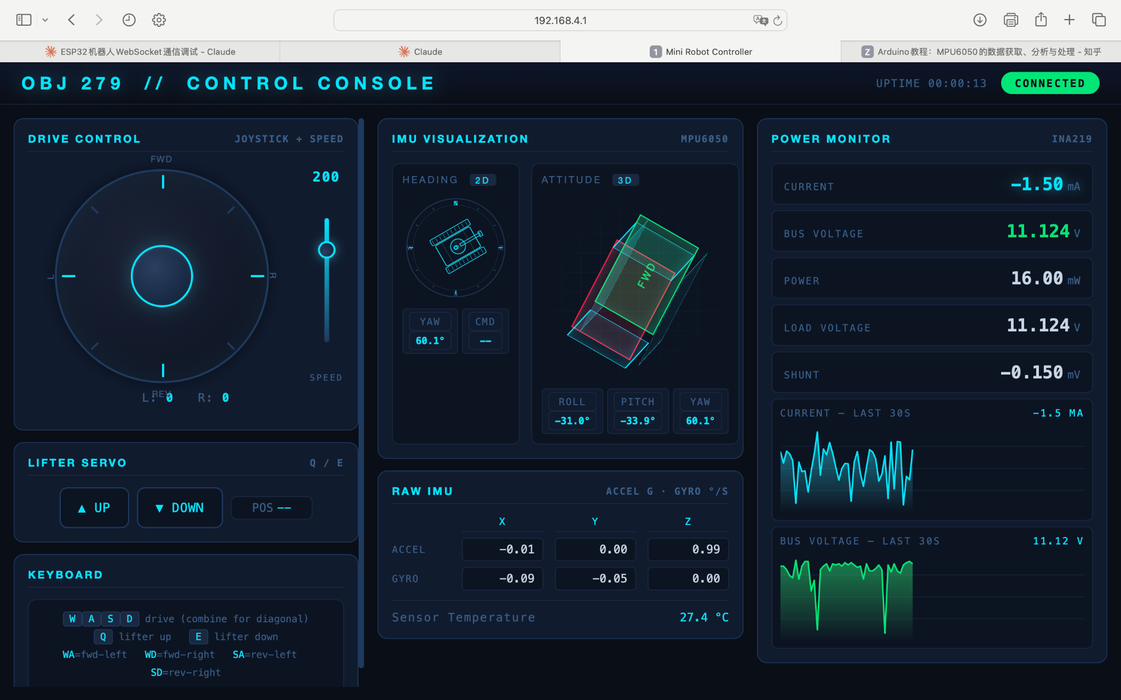
Software Features
ELECTRICAL & COMPUTER ENGINEERING
GRAINGER ENGINEERING
Notes:
Quick here, just mention how our requirements for this subsystem are as follows and how we’re using a 300mah battery and a 3v3 buck

Slide 14
Verification Results
✓ 3.3 V rail: 3.36 V avg, within ±5%
✓ Safety: link-loss/fault sets PWM = 0%
ELECTRICAL & COMPUTER ENGINEERING
GRAINGER ENGINEERING
Notes:
Talk about how the older battery has the following c-rate and estimated duration based of the current draws we calculated off the datasheet, then after the new battery swap and the measured current draw, we were able to still meet our requirements while sizing down our battery and being well within the recommended c-rate and have more than a 50% safety factor on the duration

Slide 15
Power Supply & Safety Subsystem
ELECTRICAL & COMPUTER ENGINEERING
GRAINGER ENGINEERING

Slide 16
Subsystem Overview
Battery supplies motor and major power rail
3.3 V powers ESP32 sensor chips
Kill switch and fault protection disable motion safely
ELECTRICAL & COMPUTER ENGINEERING
GRAINGER ENGINEERING

Slide 17
Verification Results
✓ Buck output: 3.24 V avg
✓ Ripple: 60 mV
✓ Error: 1.8% → within ±5%
✓ Safety: kill switch cuts motor power
ELECTRICAL & COMPUTER ENGINEERING
GRAINGER ENGINEERING
Notes:
Talk about how the older battery has the following c-rate and estimated duration based of the current draws we calculated off the datasheet, then after the new battery swap and the measured current draw, we were able to still meet our requirements while sizing down our battery and being well within the recommended c-rate and have more than a 50% safety factor on the duration

Slide 18
Drive Subsystem
ELECTRICAL & COMPUTER ENGINEERING
GRAINGER ENGINEERING

Slide 19
Subsystem Overview
DRV8871 drivers control motors
Supports speed limiting
ELECTRICAL & COMPUTER ENGINEERING
GRAINGER ENGINEERING
Notes:
Talk about how there are 3 integrated motor driver mcf8316a chips that can take a pwm signal and convert it into 3 phase AC current, and then we have 2 drive motors that use tangential drive and 1 hub motor that is used for the weapon and all these have 3 phase, and the main requirement is to have good throttle accuracy while not sacrificing the power limit of the motors

Slide 20
Verification Results
✓ Drive speed: measured 1310 RPM at 25% throttle
✓ Expected speed: 1562.5 RPM
✓ Speed error: 16.6%
✓ Cause: friction losses from tangential wheel drive
ELECTRICAL & COMPUTER ENGINEERING
GRAINGER ENGINEERING
Notes:
Talk about how the older battery has the following c-rate and estimated duration based of the current draws we calculated off the datasheet, then after the new battery swap and the measured current draw, we were able to still meet our requirements while sizing down our battery and being well within the recommended c-rate and have more than a 50% safety factor on the duration

Slide 21
Weapon Subsystem
ELECTRICAL & COMPUTER ENGINEERING
GRAINGER ENGINEERING

Slide 22
Subsystem Overview
Servo receives direct GPIO signal
Large torque servo ensures force output
ELECTRICAL & COMPUTER ENGINEERING
GRAINGER ENGINEERING

Slide 23
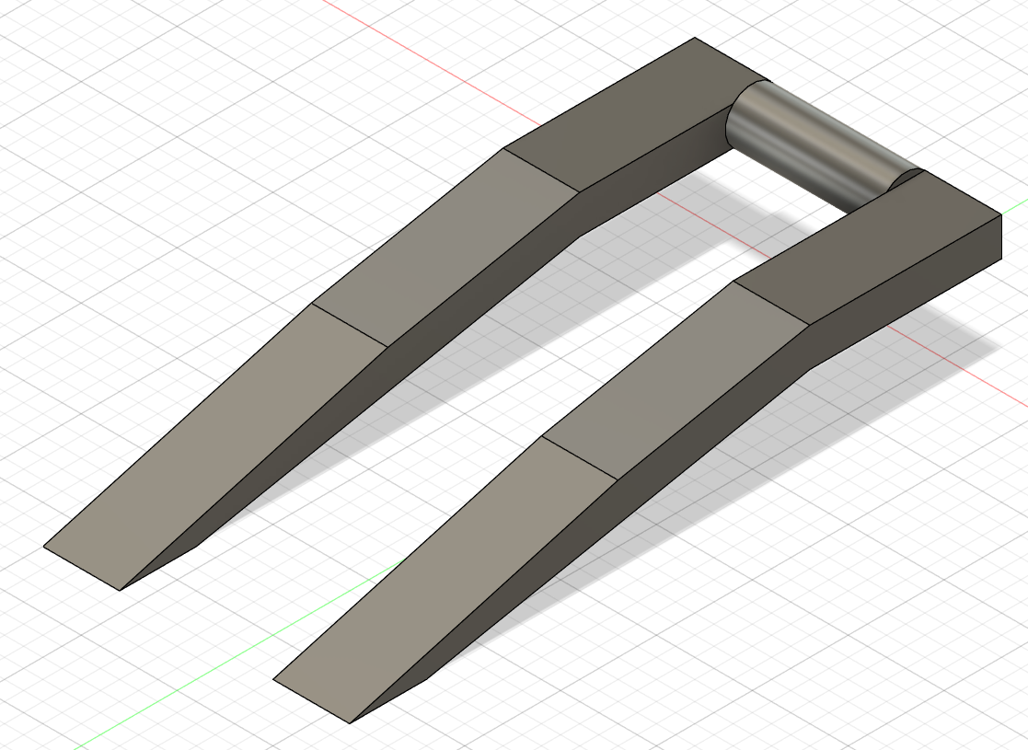
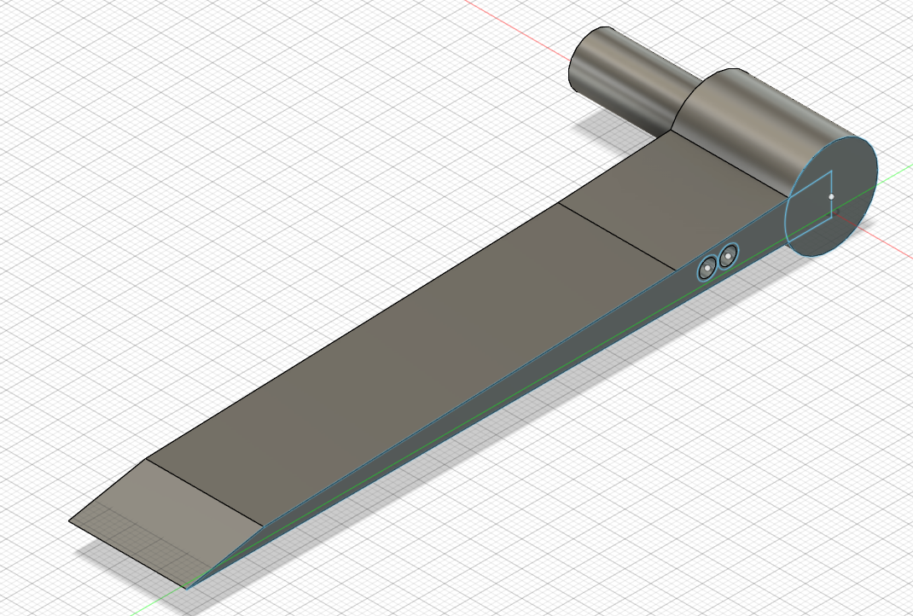
Weapon Motor Changes
Original Design
New Design
ELECTRICAL & COMPUTER ENGINEERING
GRAINGER ENGINEERING
Notes:
We made the transition from 2 integrated mcf chips and 1 gate driver with a 3 leg inverter to 3 chips because of our reduced current draw measurements, initially, our weapon motor was specced for 40A which was more than the limit of the mcf8316a chips so we had a gate driver with 6 mosfets instead, but after doing the current measurements, we realized we could use 3 mcf chips and save on space and bring up time by only having to verify that 1 chip was working, which was a huge success

Slide 24
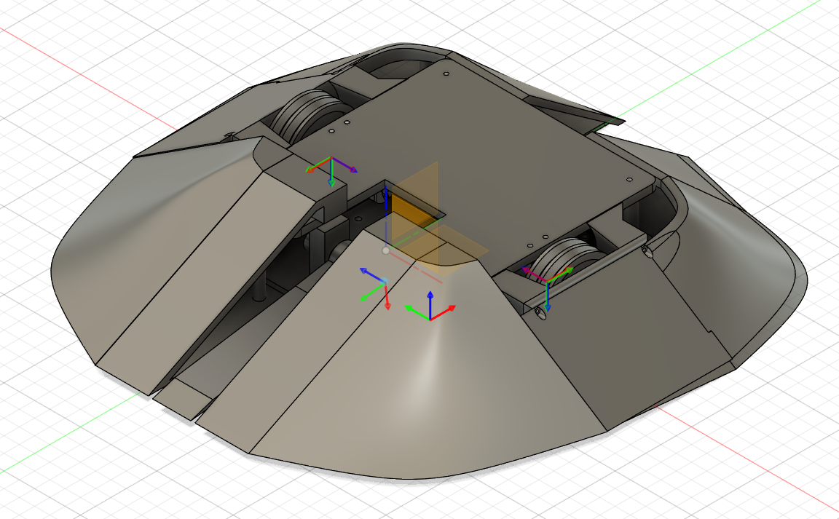
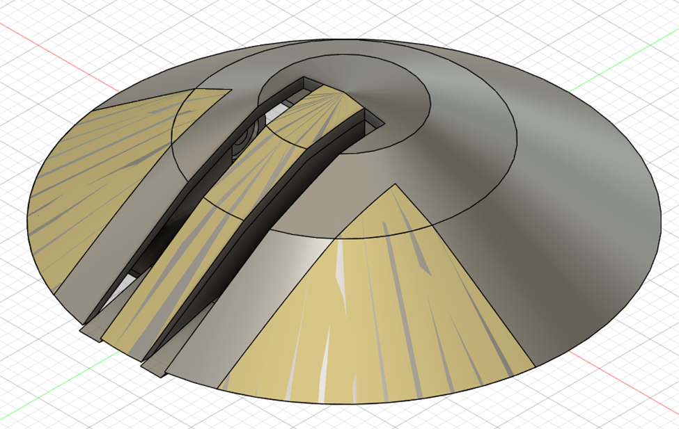
Design Iterations
Version 1
Version 2
ELECTRICAL & COMPUTER ENGINEERING
GRAINGER ENGINEERING

Slide 25
Verification Results
✓ Throttle limit: tested up to 22.5%
✓ Tip speed check: surpassed 150 mph target
✓ Calculation: v = 2πr × RPM / 60
✓ Design change: larger weapon radius increased tip speed
ELECTRICAL & COMPUTER ENGINEERING
GRAINGER ENGINEERING
Notes:
Talk about how the older battery has the following c-rate and estimated duration based of the current draws we calculated off the datasheet, then after the new battery swap and the measured current draw, we were able to still meet our requirements while sizing down our battery and being well within the recommended c-rate and have more than a 50% safety factor on the duration

Slide 26
Discussions
ELECTRICAL & COMPUTER ENGINEERING
GRAINGER ENGINEERING

Slide 27
Reflection
Successes
Wifi control successfully sends motor commands to ESP32-S3
Mechanical redesign improved chasis stability
Challenges
PCB bring-up required careful I2C/PWM initialization
Integration space was limited inside the compact chassis
ELECTRICAL & COMPUTER ENGINEERING
GRAINGER ENGINEERING

Slide 28
Conclusion
What We Learned
Real measurements are critical for validating design assumptions
Always start early
Mechanical packaging strongly affects electrical and software choices
What Are The Next Steps
Improve chassis and weapon contact surfaces
Refine software UI for easier driving and debugging
ELECTRICAL & COMPUTER ENGINEERING
GRAINGER ENGINEERING

Slide 29


Slide 30
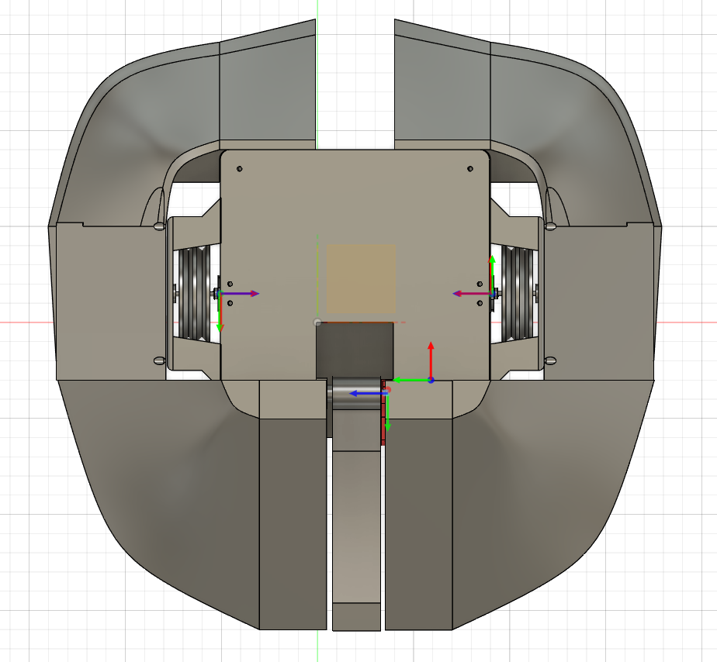
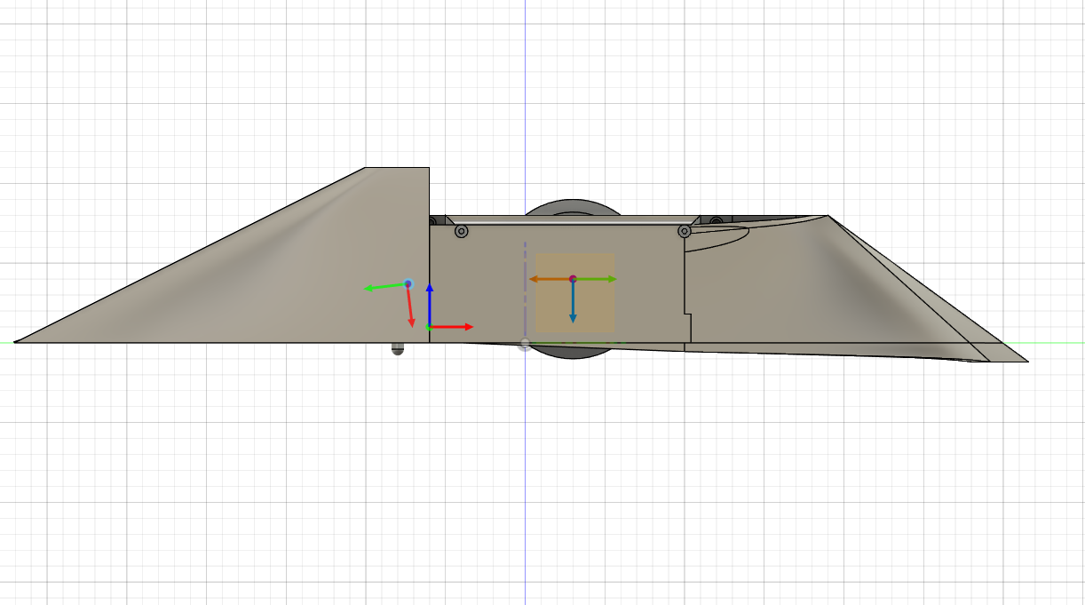
Appendix: Visual Aids
ELECTRICAL & COMPUTER ENGINEERING
GRAINGER ENGINEERING

Slide 31
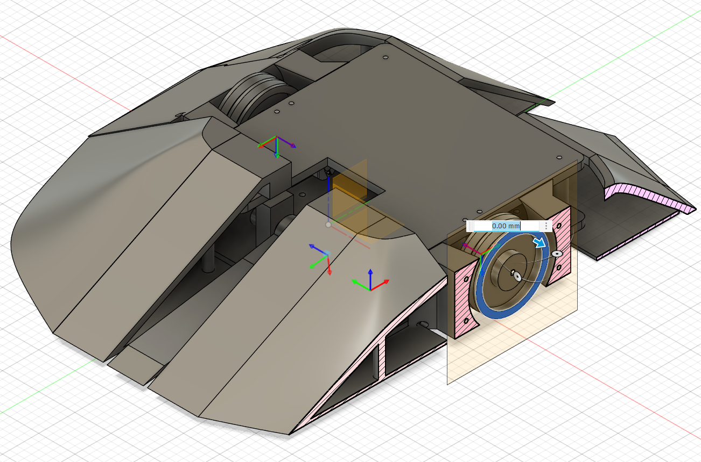
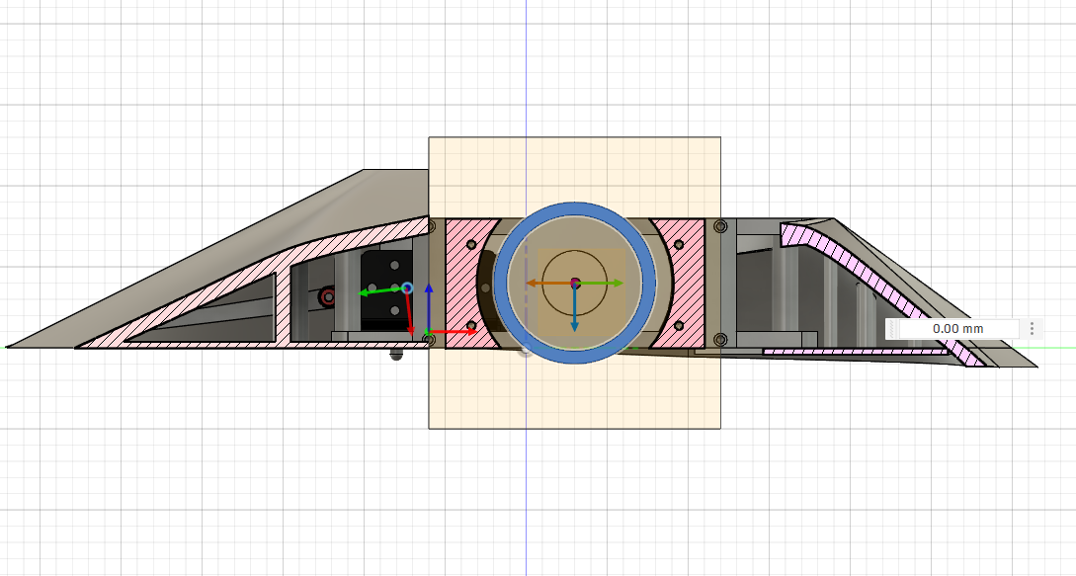
Appendix: Visual Aids
ELECTRICAL & COMPUTER ENGINEERING
GRAINGER ENGINEERING

Slide 32
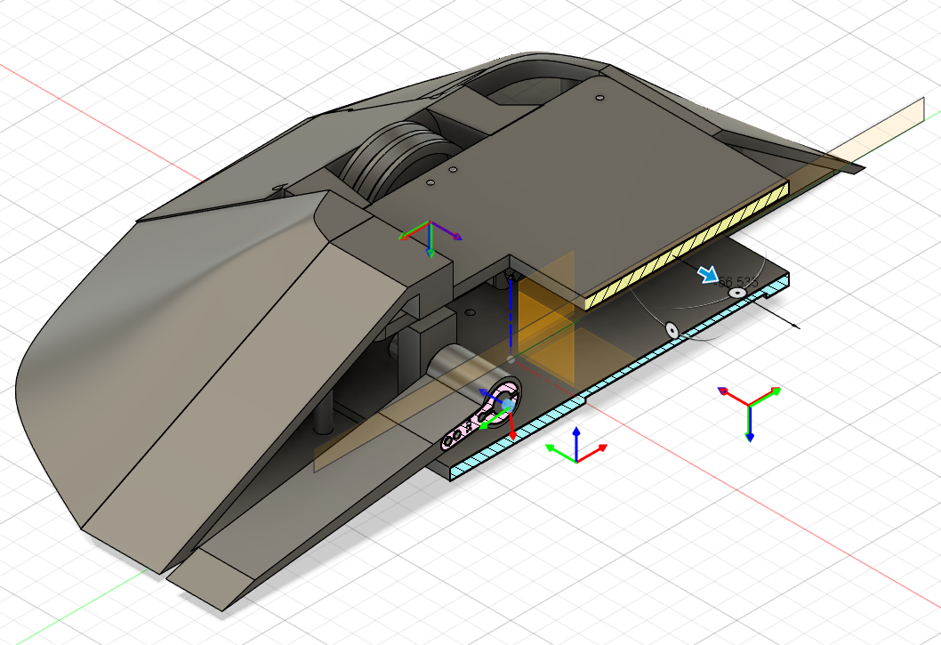
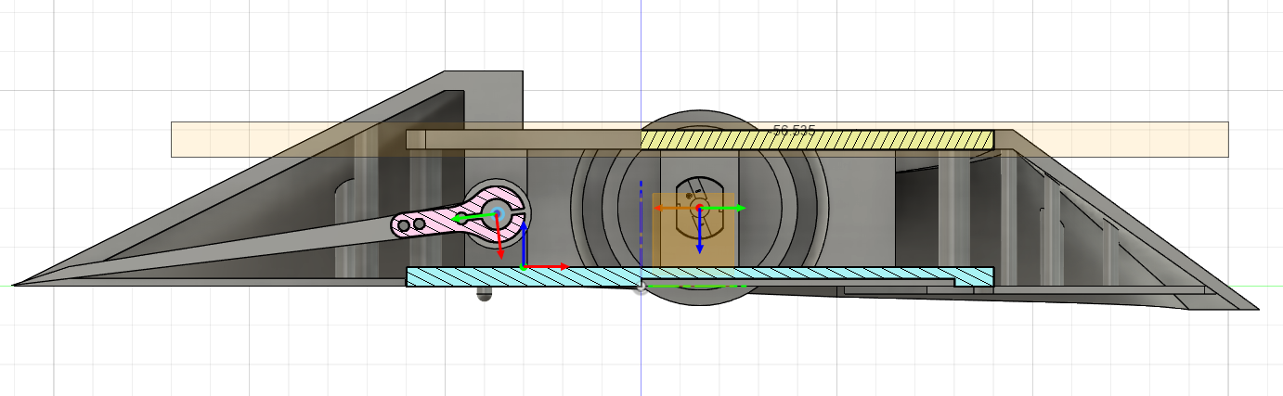
Appendix: Visual Aids
ELECTRICAL & COMPUTER ENGINEERING
GRAINGER ENGINEERING

Slide 33
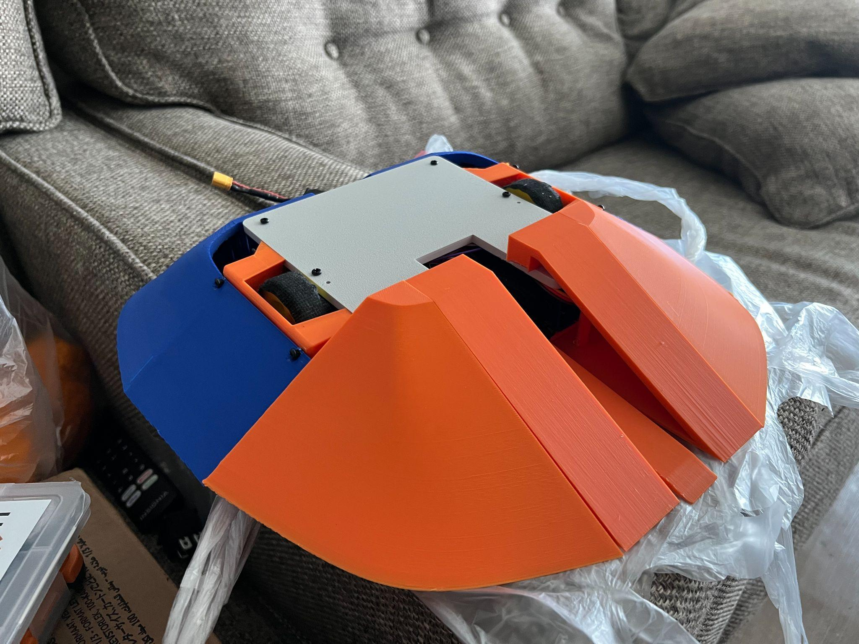
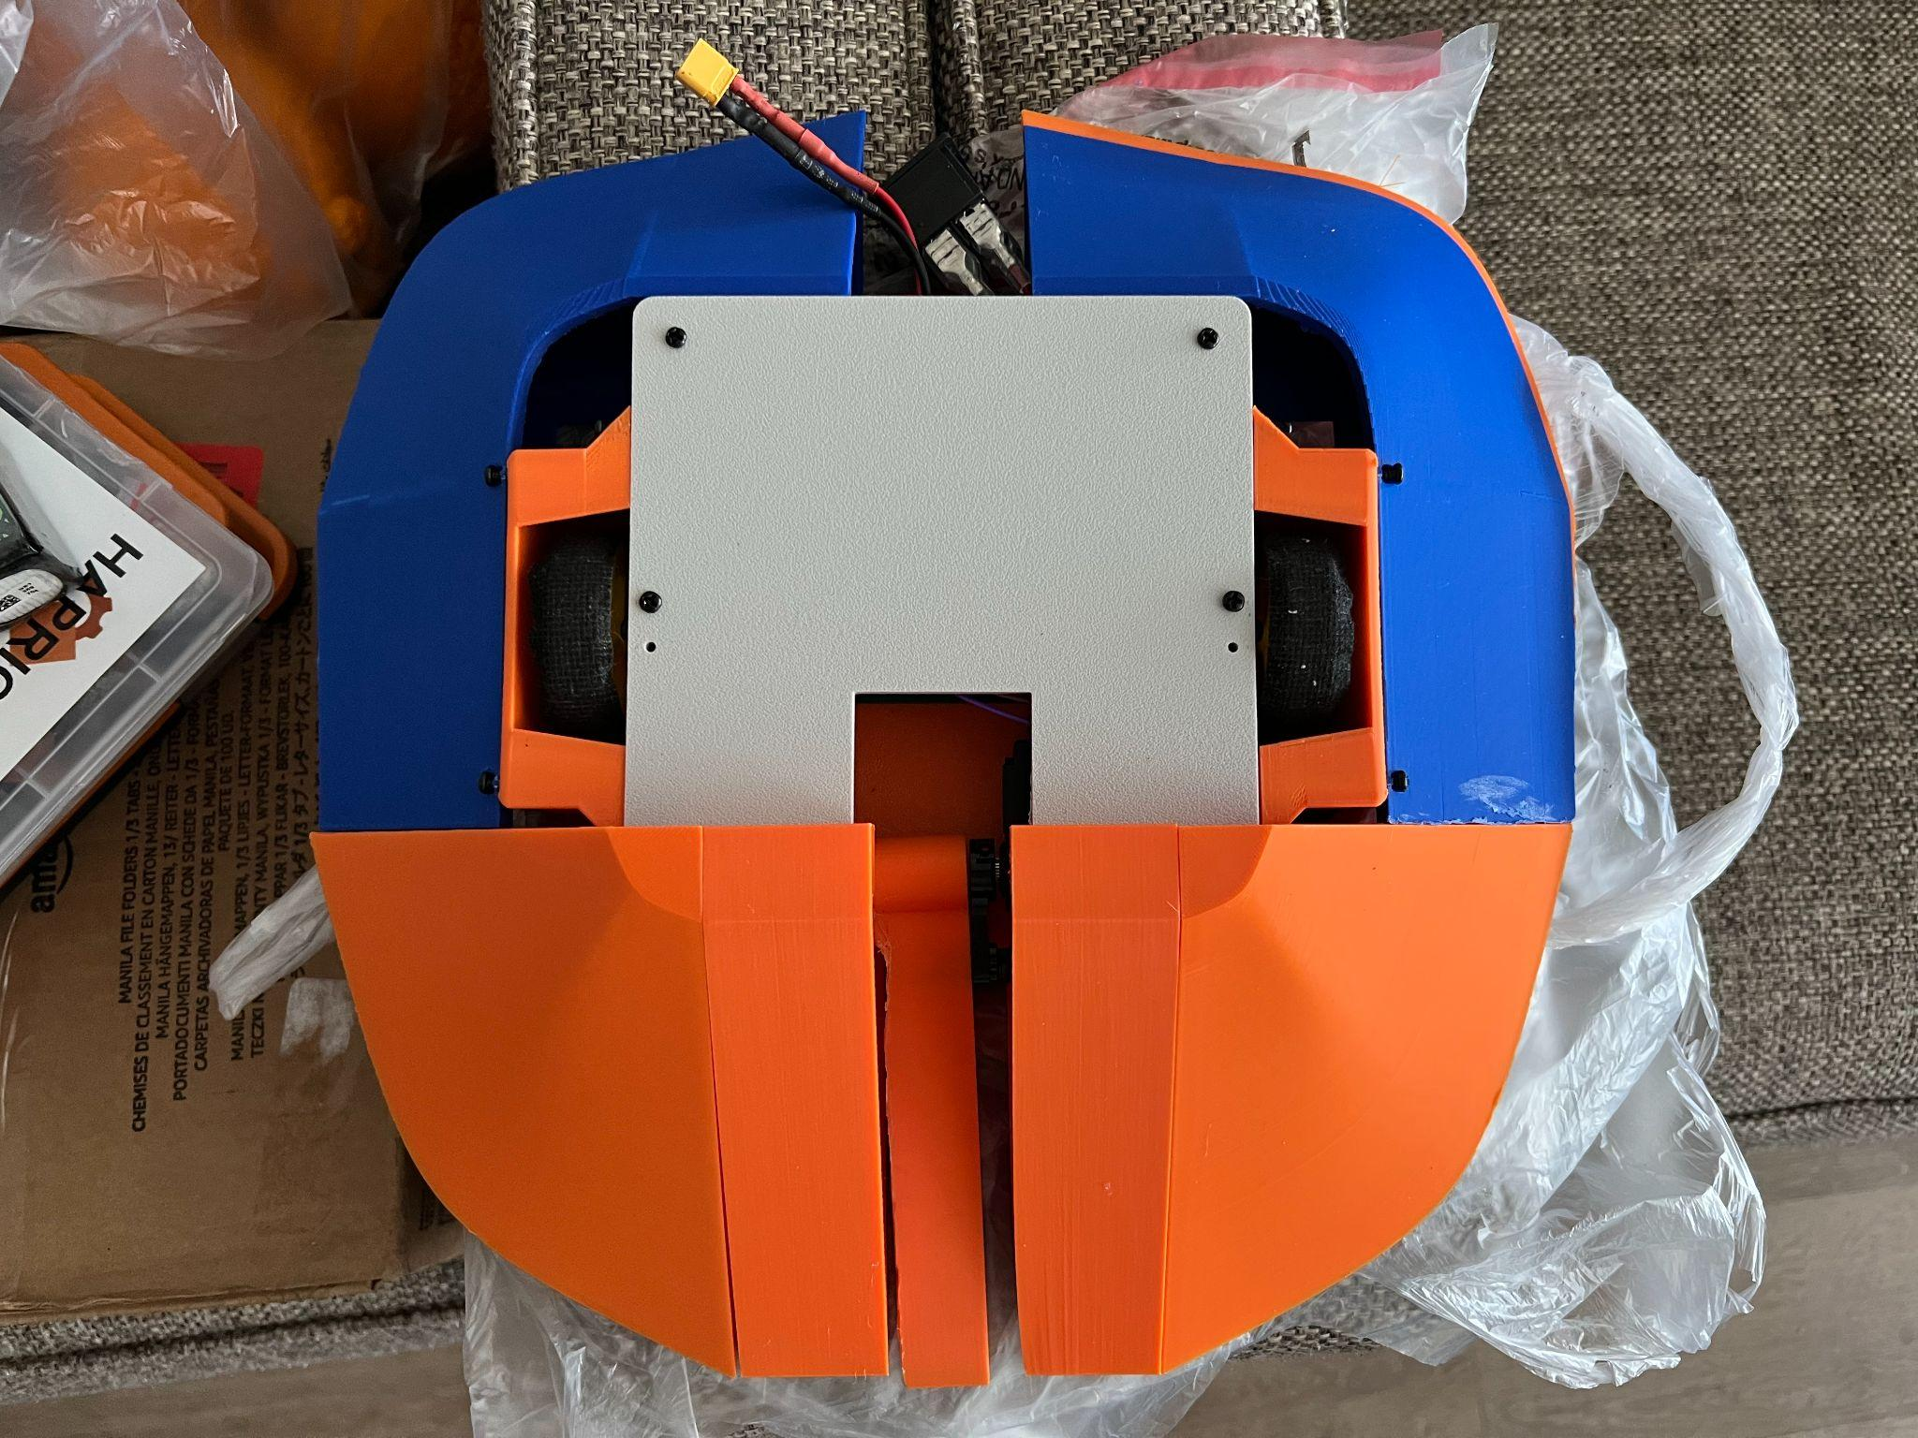
Appendix: Visual Aids
ELECTRICAL & COMPUTER ENGINEERING
GRAINGER ENGINEERING

